Slide 1



SMA & HULL TACTICAL
Predicting SPY Returns
Using Social Market Analytics
Students：
Aparna Avinash Kesarkar
Chinmayi Kargal Manjunath
Joseph J. Loss
Sihan Li
Yuchen Duan
Zenith Zhou
Sponsor：
Alexander Kment
Zishan Cai

Slide 2
CONTENTS
Overview
Model
Analysis
02
04
70.46% returns vs. 11.32% given by SPY.
Implement multiple machine learning models with parameter tuned
Overall evaluation and improvement
01
Data
03
Backtest
05
Feature 100 Factors from twitter sentiment estimate and SPY prices
Translate signal to Portfolio

Slide 3





Background
A
B
SMA
HTAA
Social Market Analytics, Inc. build predictive sentiment
data feeds
Hull Tactical Asset Allocation serves as an Sub-Adviser to an ETF
Use Social Market Analytics sentiment data feed and pricing data to generate a one-day SPY prediction.

Slide 4
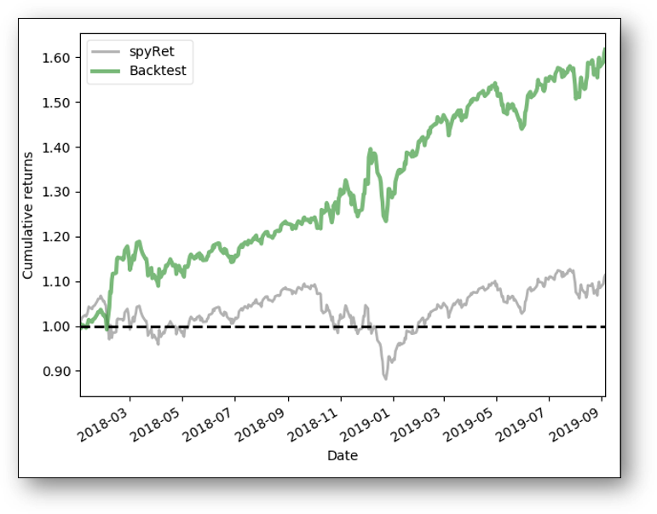
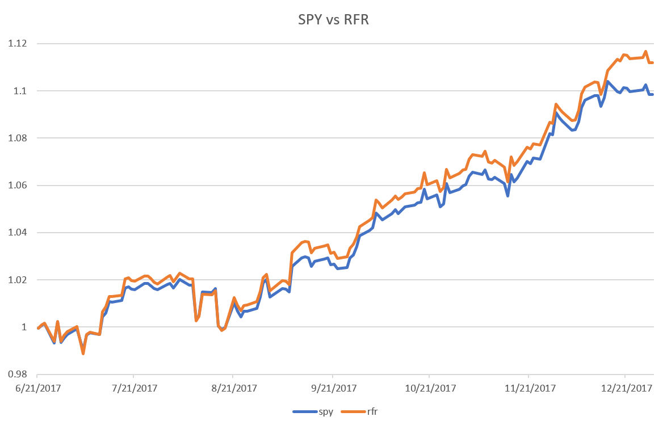
Overview
Design Set [2015/7-2017/12]
Train [2015/7-2017/6] Test [2017/6-2017/12]
Apply Set [2018/1-2019/9]
Cumulative return 11.20% Vs. SPY 9.84%
Strategy works best in bearish markets.
Cumulative return of 70.46% for the period, massively out-performing SPY, which returned 11.32% during the same time frame.

Slide 5
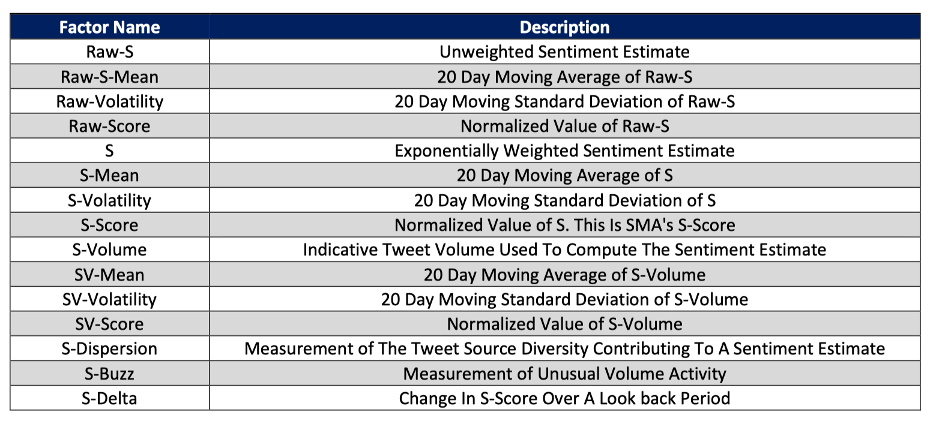
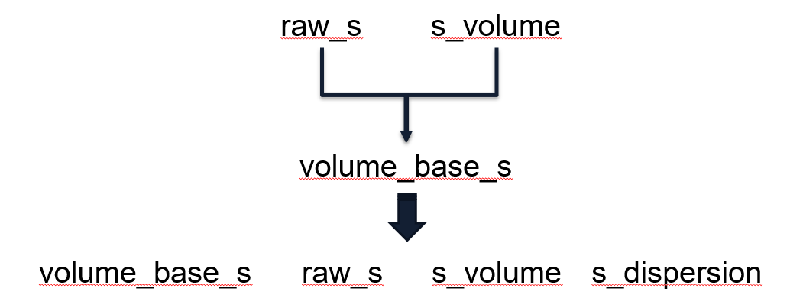

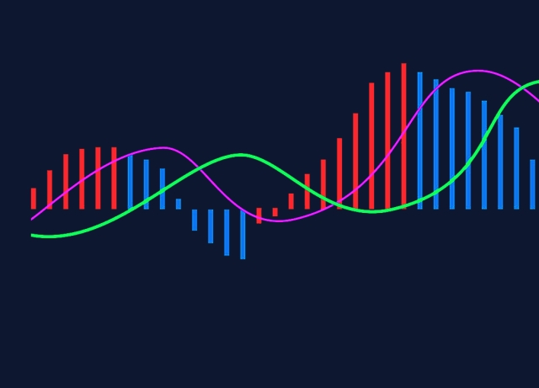


Data
EWM
Wavelet
Factor Name | Description
raw_s | Unweighted Sentiment Estimate
s-volume | Indicative Tweet Volume Used to Compute the Sentiment Estimate
s-dispersion | Measurement of the Tweet Source Diversity Contribution to a Sentiment Estimate
date | format YYYY-MM-DD hr:min:sec increment by min
$$e^{x}$$
Z
$$Z$$
Exponential weighted raw min data
Wavelet decode wave
26 days rolling Z-source.
Factors
MACD
Delta
-
Difference between long short ewma.
daily delta of mean.

Slide 6
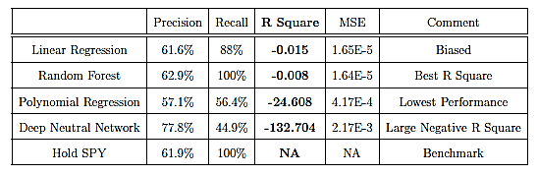




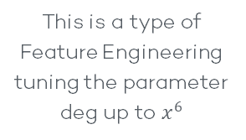
Model
Random Forest
Deep Learning
Linear
Polynomial
Elastic Net Model tuning the parameter α and L1 ratio total 100000 sets
This is a type of Feature Engineering tuning the parameter deg up to $x^{6}$
both Regressor and Classier tuning the parameter
max leaf nodes and n estimators
DNN Model tuning the parameter size of 3 layers total
1000 sets

Slide 7
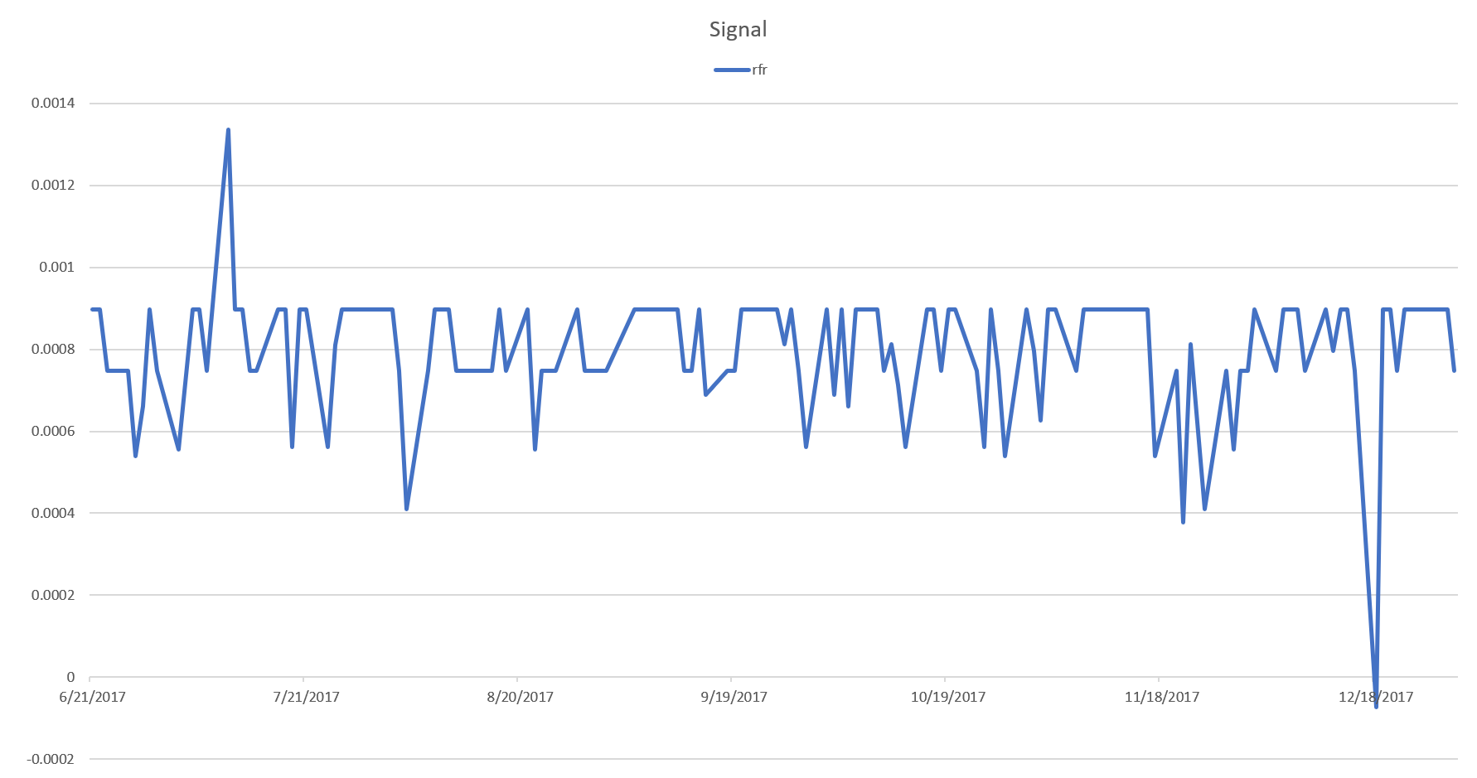
Strategy

Slide 8
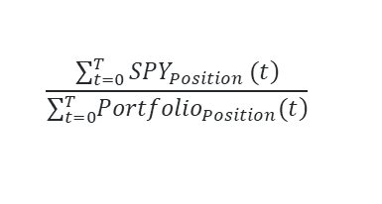
Risk
01
02
03
04
Sharpe Ratio
Downward risk
Tail Event
Delta
$$\frac{\left.\sum_{t=0}^{T}{SPY_{Position}}(t\right)}{\sum_{t=0}^{T}{\left.{Portfolio}_{Position}(t\right)}}$$
Relative return when consider the volatility as the risk level
Consider only the downside volatility to analyze the loss
Analyze VaR and ES to figure out the losses in worst case

Slide 9
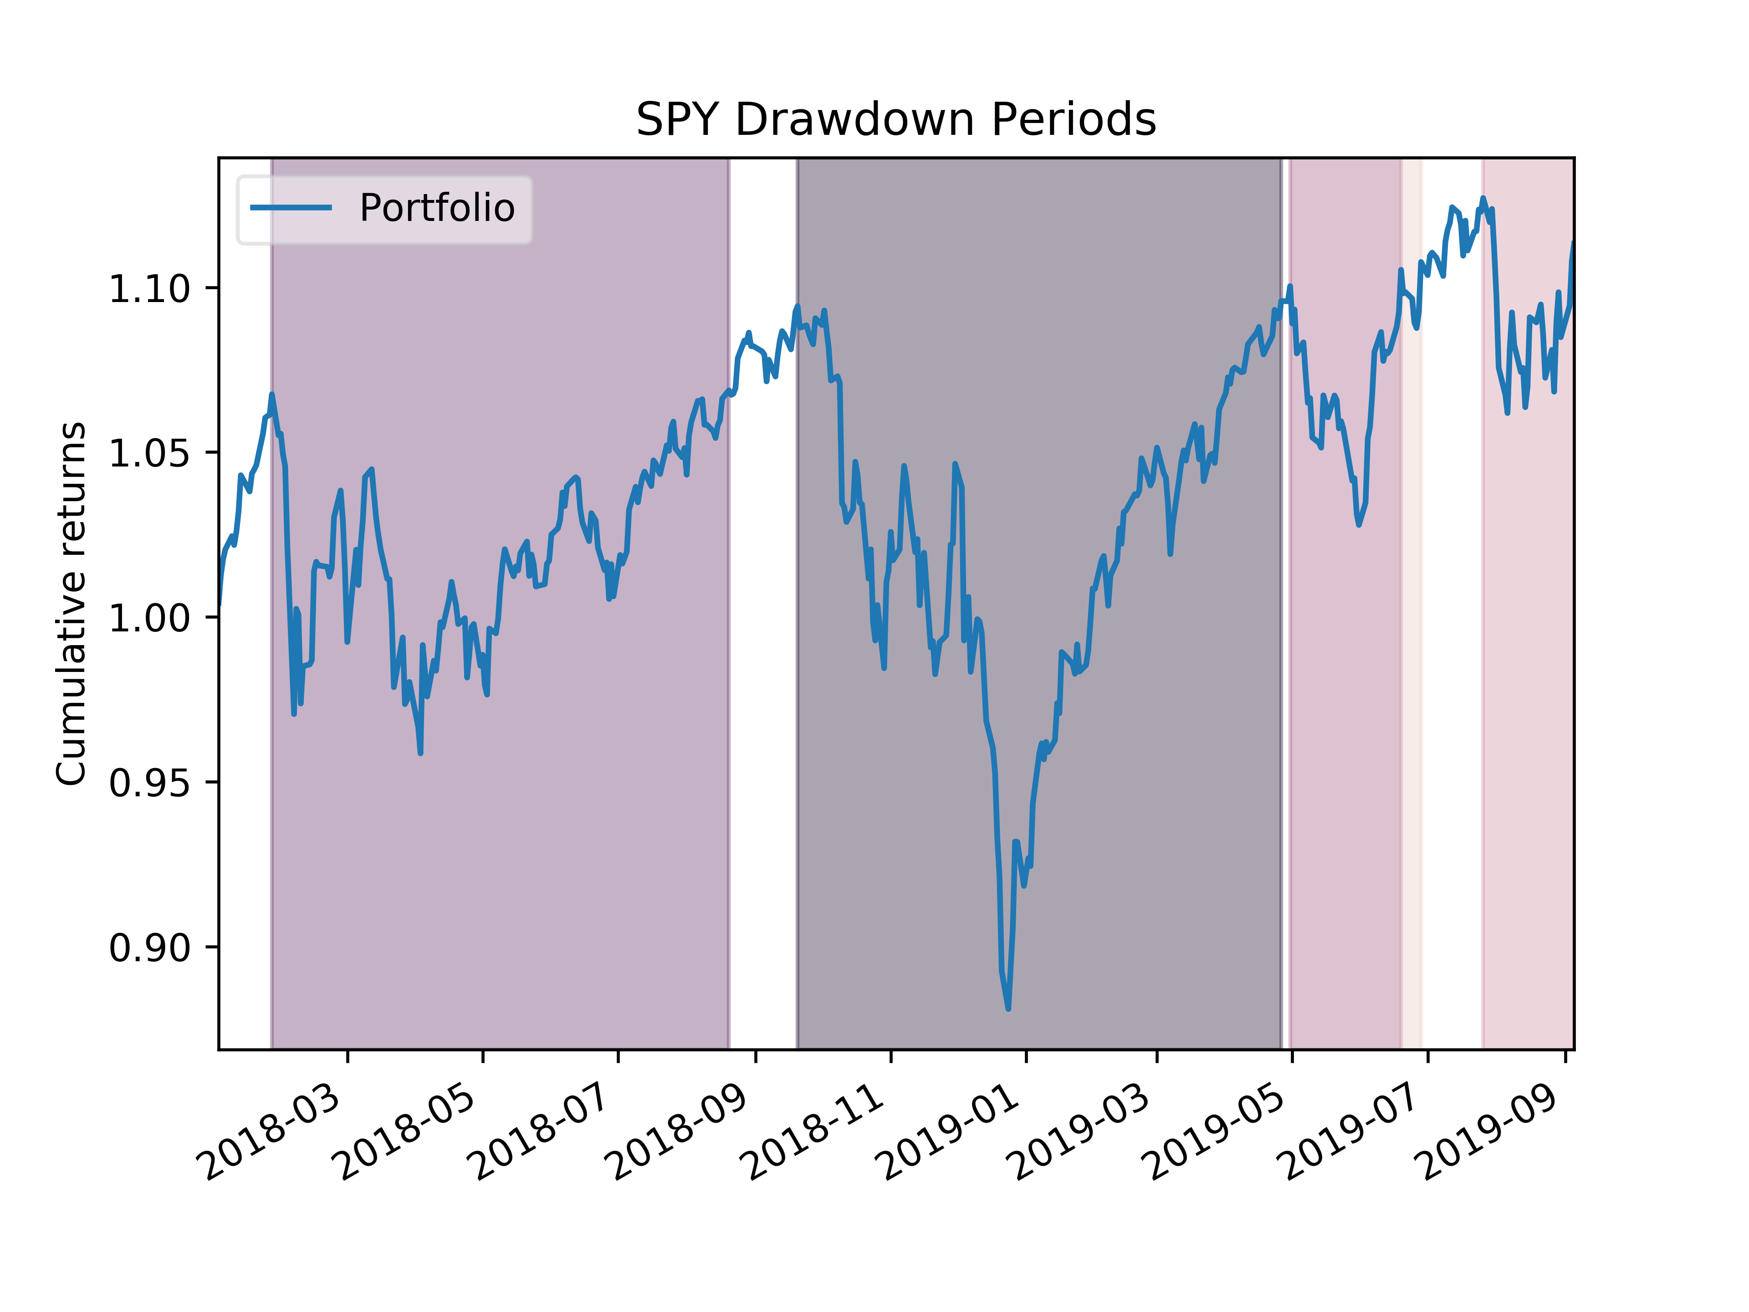
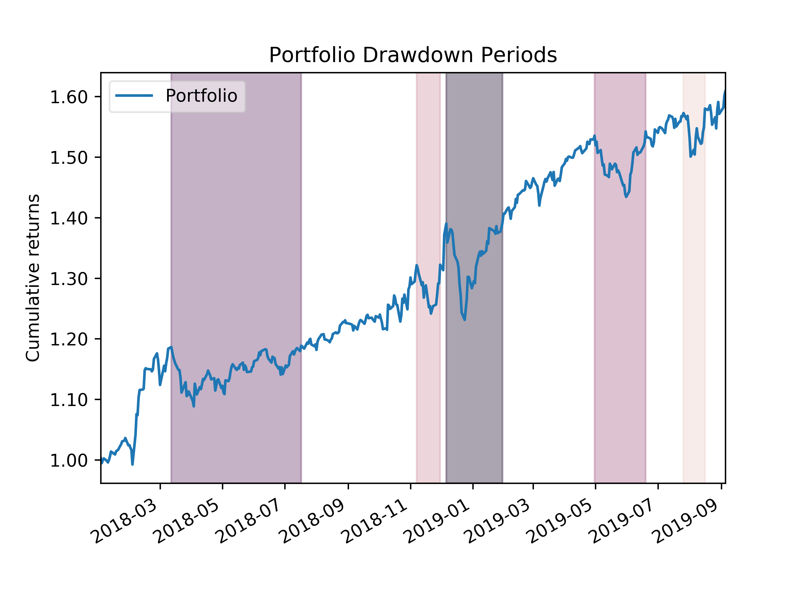
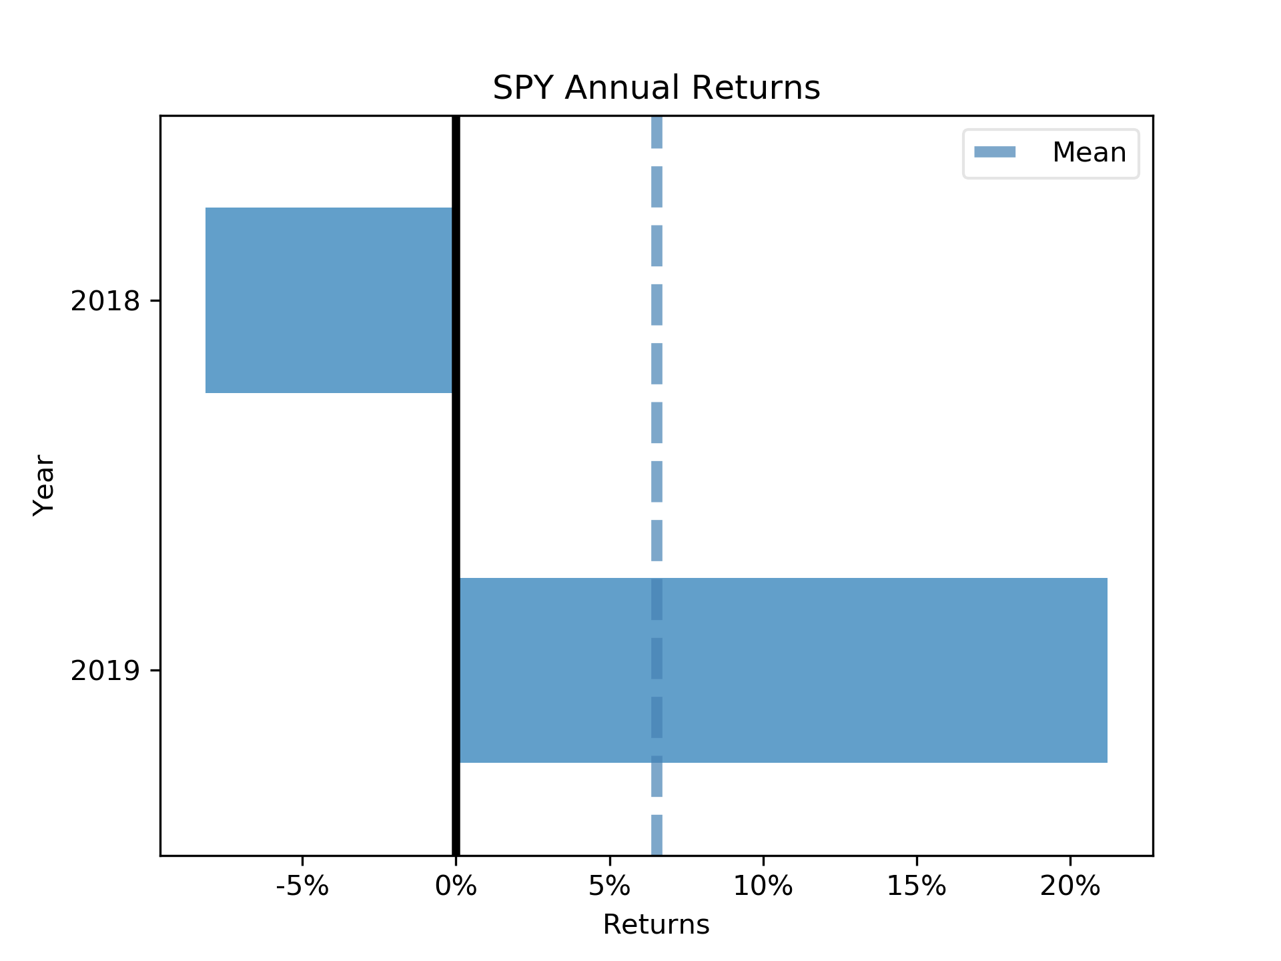
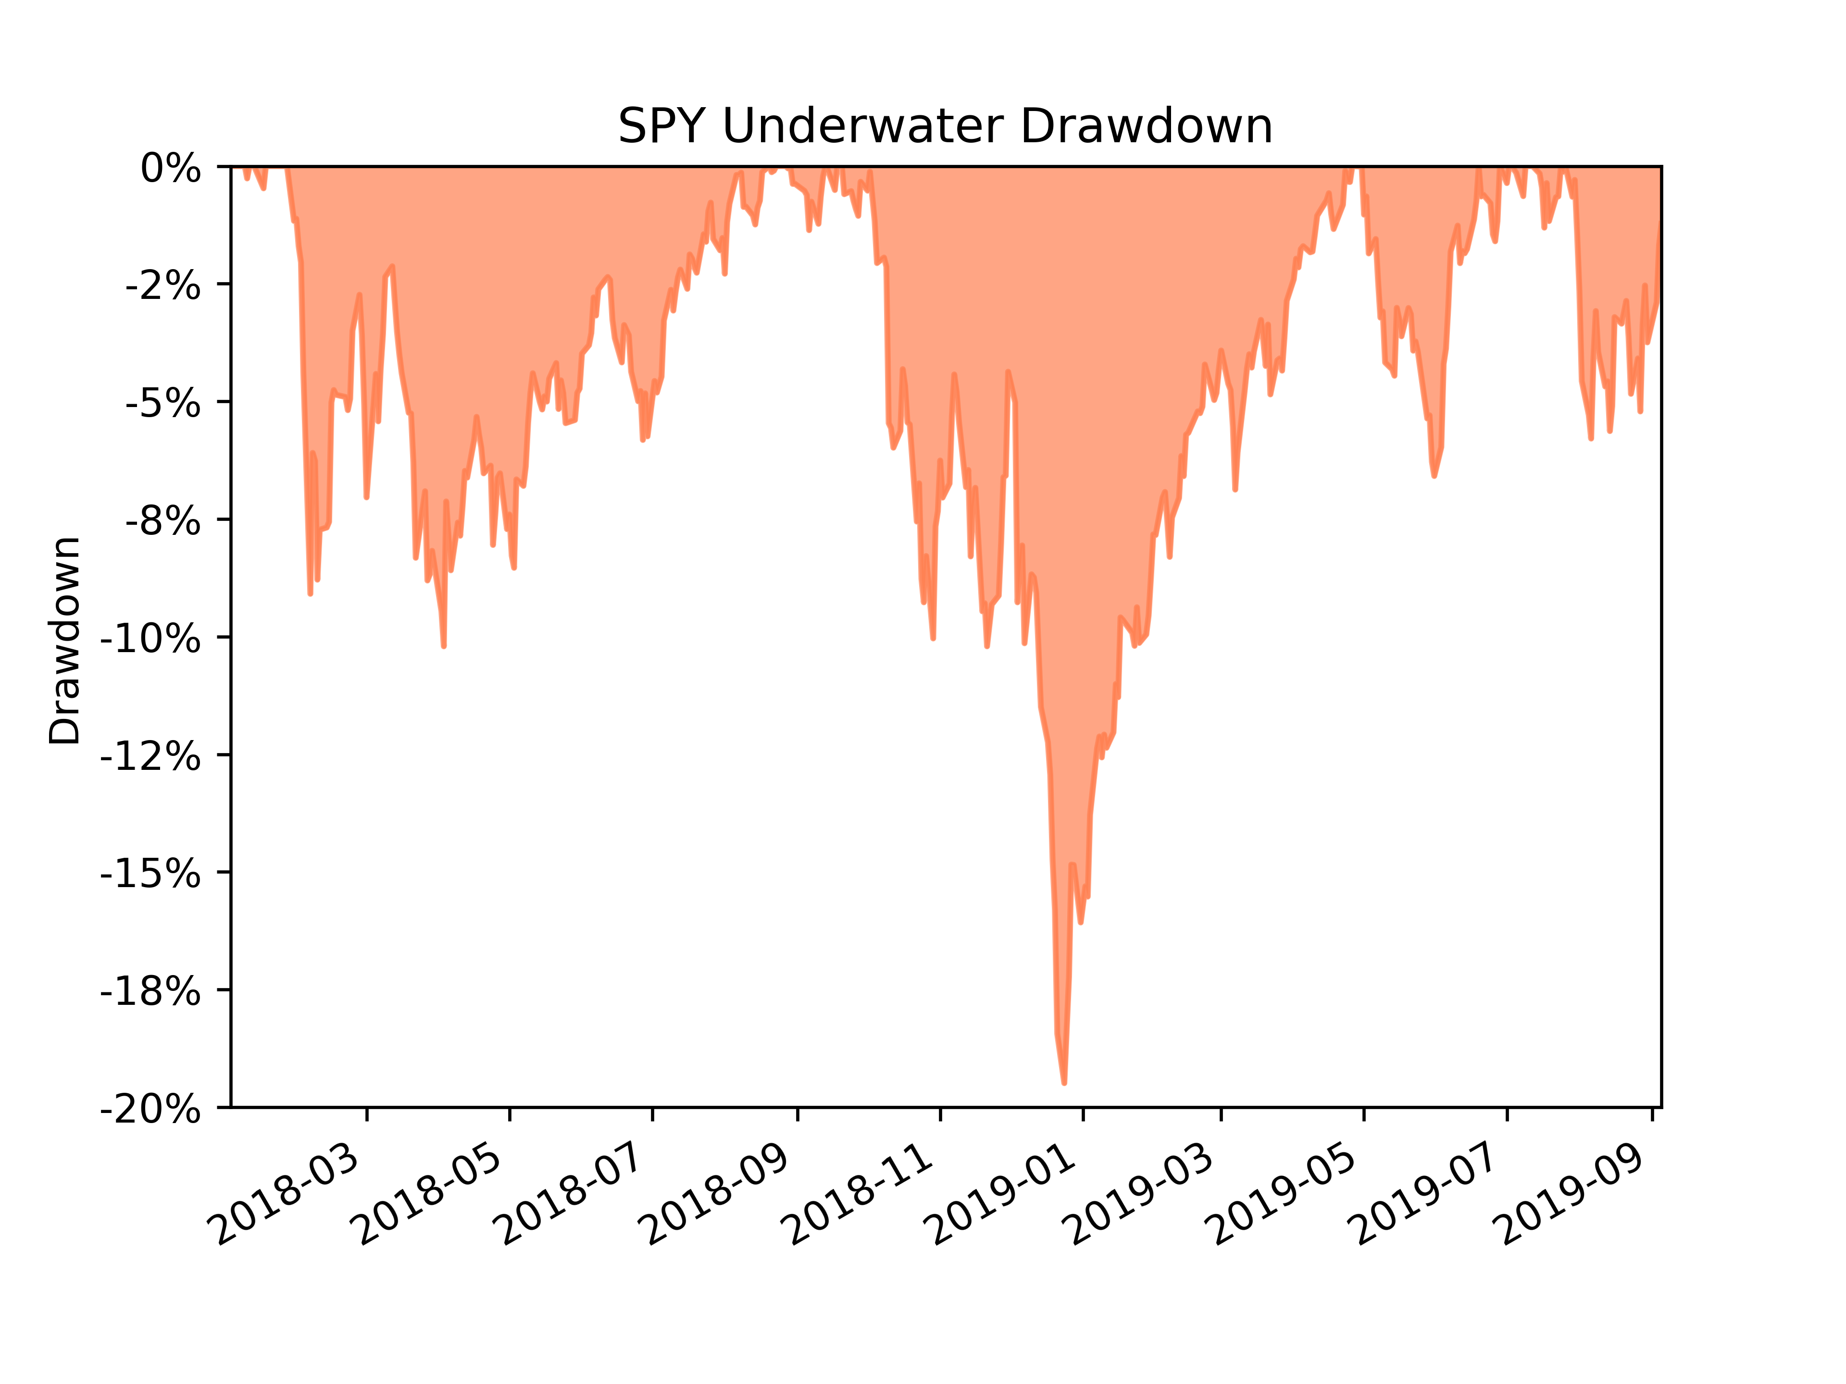
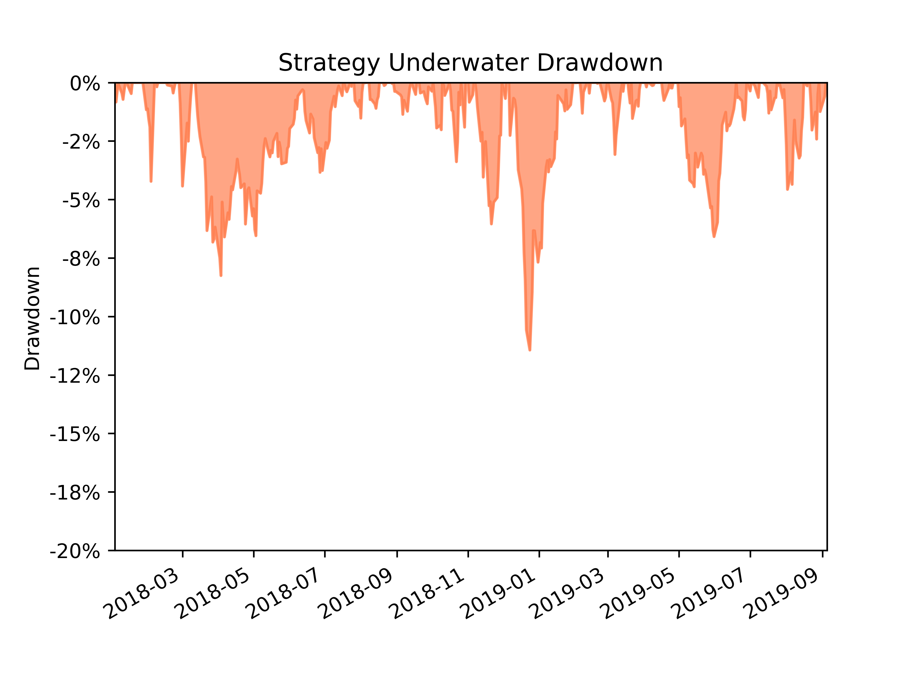
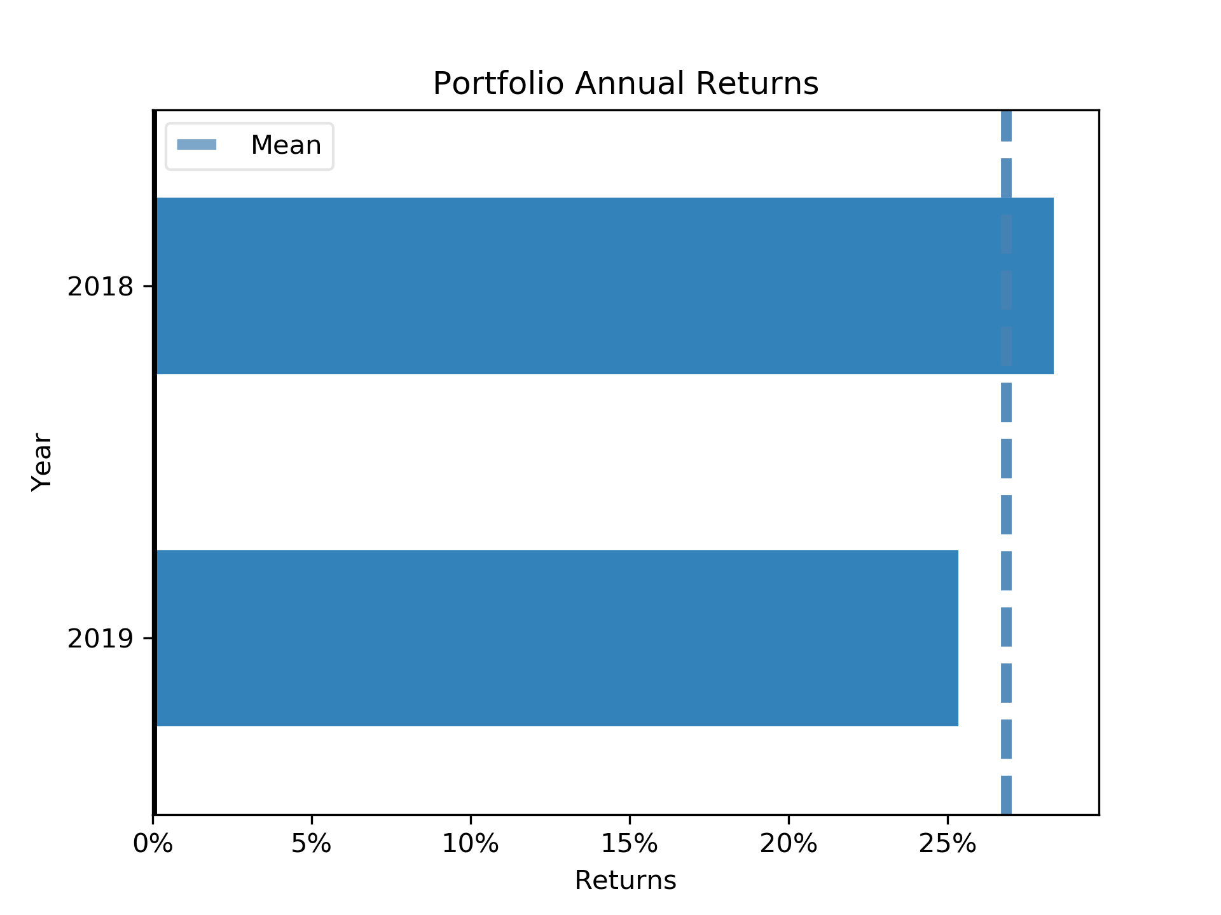
Short Period
Analysis

Slide 10
Improvment
Risk Factor
More Data BackTest
01
02
To minimize the risk and maximize the return
Increase the confidence.
Rebalancing
Look into Trees
03
04
Re-train the model in different frequency can have different results
What cause the high precision on negative prediction

